Slide 1
Seoul Res
Database Web Programming
18102086 Sangjin Lee
181202080 Dongwoo Shin
21102044 Seyeon Oh
22170190 Marek Hajduk

Slide 2
Contents
1
Service Introduction
2
Pipeline
3
Data Collection
4
Data Analysis
5
Web Programming
6
Result/Limitation

Slide 3
01. Service Introduction

Slide 4






Service introduction
Our topic :
Restaurant Review Data Analysis and Price Comparison Platform

Slide 5
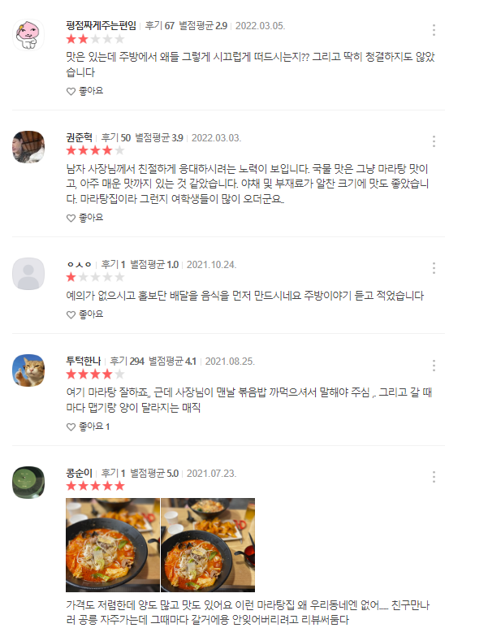


Motivation – Keywords in Review
“Review Data”
“Different rating”
“Different reason”
What is the primary reason for each high or low rating?

Slide 6
Motivation – Keywords in Review
“Review Data”
“Different rating”
“Different reason”
Is Rating truly meaningful or appropriate?

Slide 7



Service Goal – Review
1
Developing a machine learning model to classify review data into pos and neg sentiments
2
Comparing keywords obtained from ratings on the website with keywords and extracted from the machine learning model's classification of pos and neg sentiments
3
Evaluating the significance of star ratings for each restaurant

Slide 8
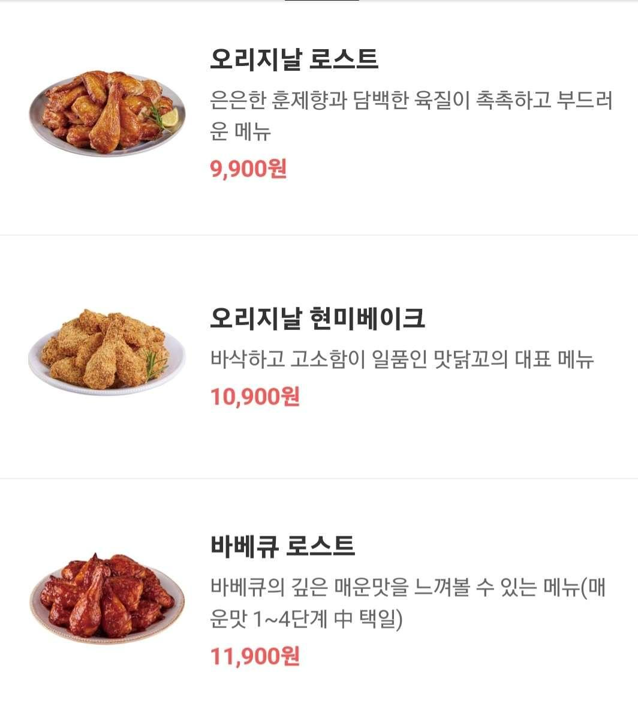
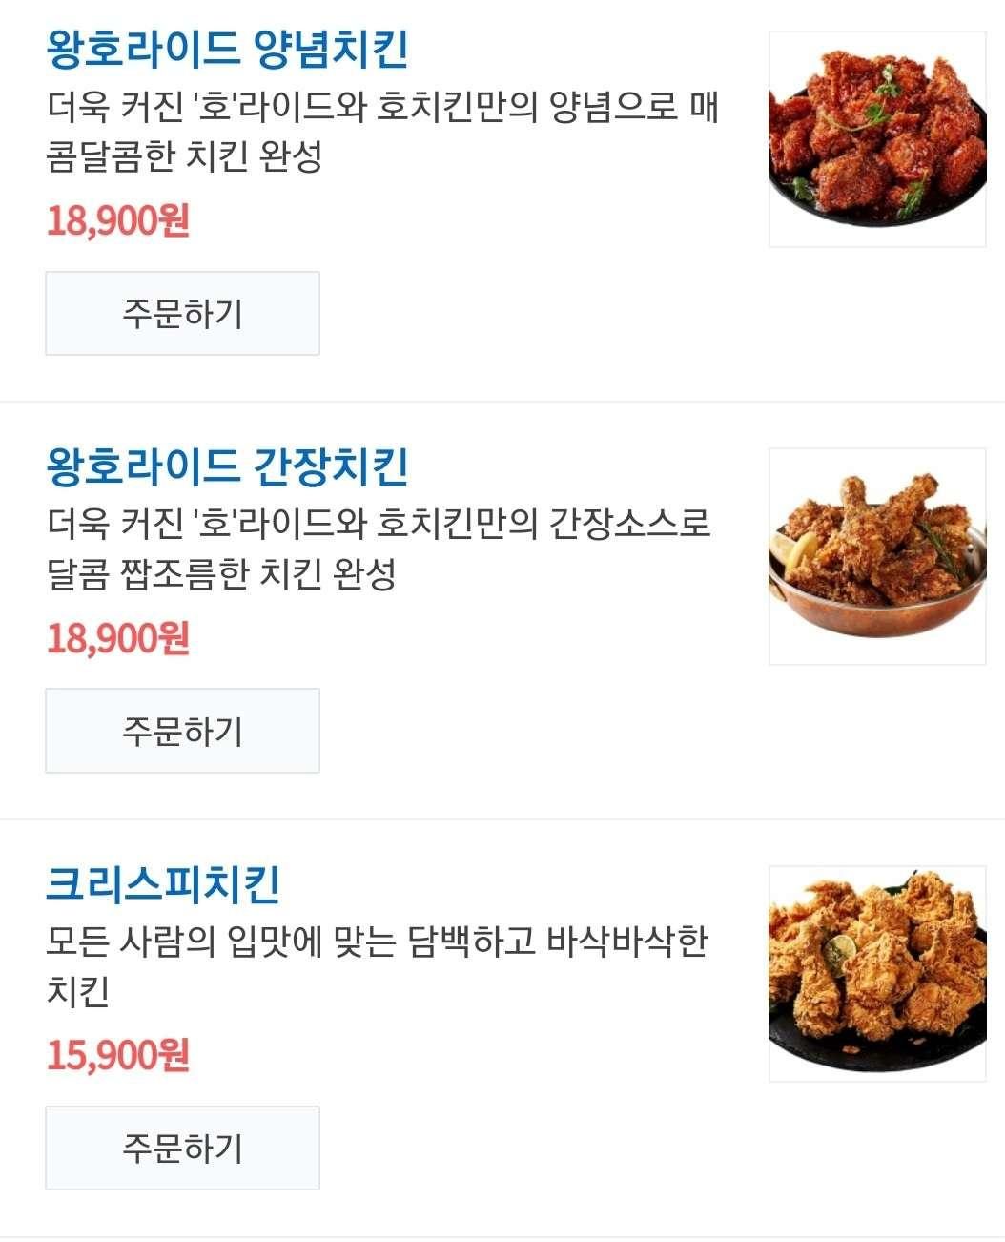

Motivation – price comparison
“Our platform will allow our users to easily compare prices between same type of restaurants”
With our platform user will be able to instantly compare prices of different places

Slide 9
02. Pipeline

Slide 10












Pipeline

Slide 11
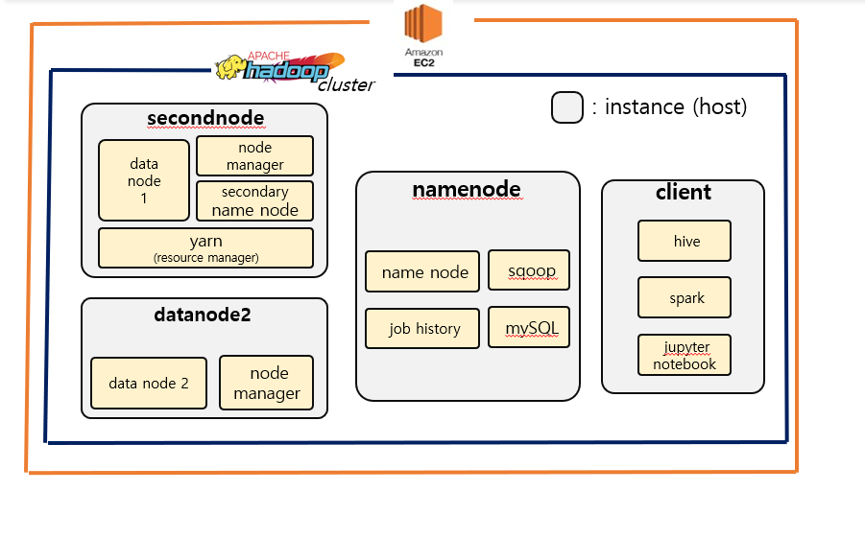
System Structure

Slide 12
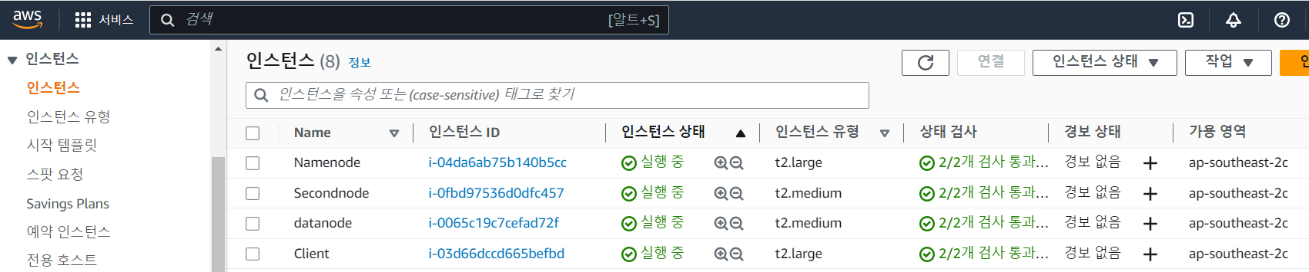
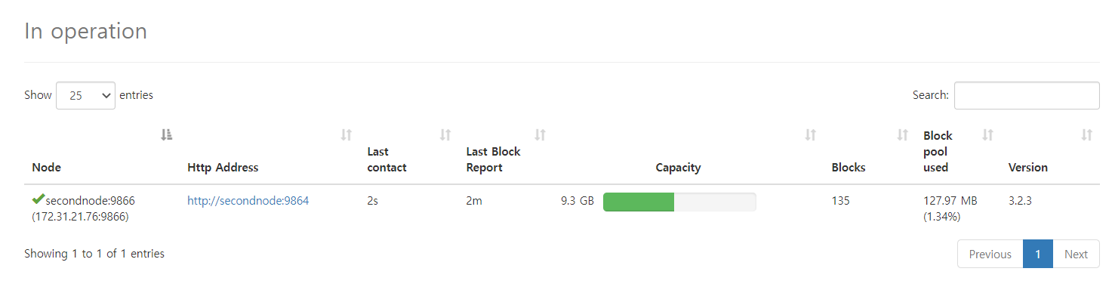
System Structure

Slide 13
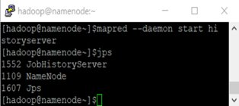
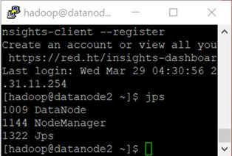
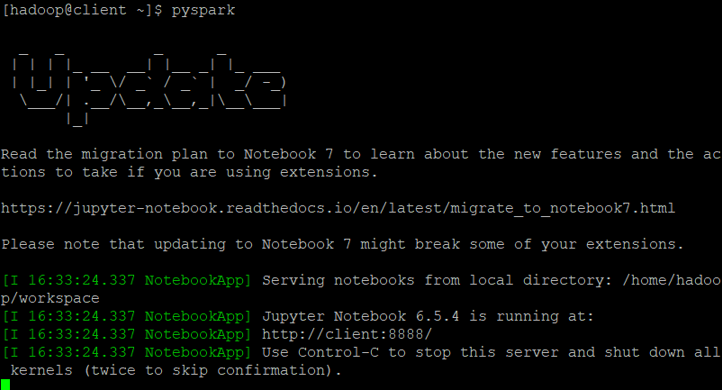
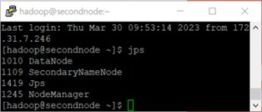
System Structure

Slide 14
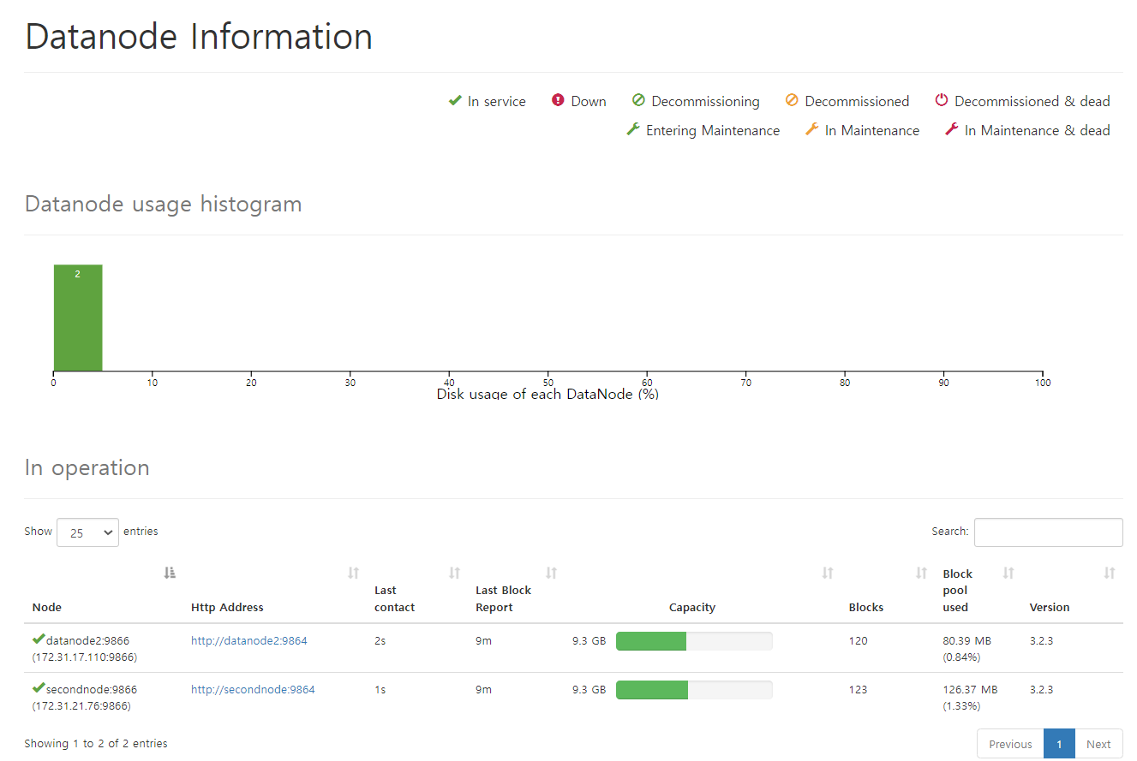
System Structure
This information describes the capacity that a data node can store.

Slide 15
03. Data Collection
Notes:
다음은 data 수집 파트입니다.

Slide 16
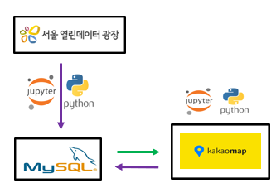
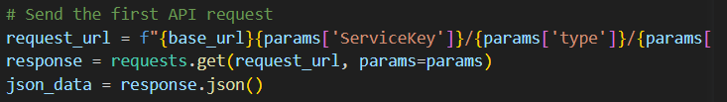
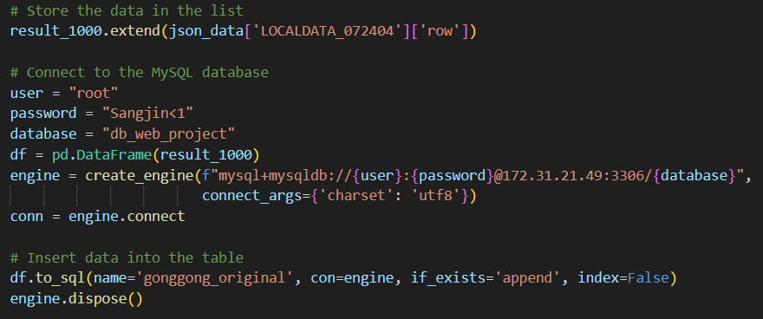
Data Collection - Restaurant Information
1. Collect data on the name, address, current operation status, and type of restaurant in Seoul from Seoul public data site
- Request Using API
- Store in the 'gonggong_original“ table of MySQL

Slide 17
Data Collection - Restaurant Information
2. Preprocessing the data in MySQL. Finally, there are 124,973 restaurants data.
Deleting the columns except what we need
ALTER TABLE `db_web_project`.`gonggong_original`
DROP COLUMN `HOMEPAGE`,
DROP COLUMN `JTUPSOMAINEDF`,
DROP COLUMN `JTUPSOASGNNO`,
．．．
Removing restaurants that have closed their operations
delete from ‘db_web_project’.’gonggong_original’ where dtlstatenm != '영업’;
- Adding the column that has average of price in their menus

Slide 18
Data Collection - Restaurant Information
2. Preprocessing the data in MySQL. Finally, there are 124,973 restaurants data.
Adding the column that is stored both Name&Dong
１） Add ADDRESS column that stores addresses before 'East' in FULL_ADDRESS column
alter table db_web_project.gonggong_original add column ADDRESS text;
update db_web_project.gonggong_original set ADDRESS = substring_index(FULL_ADDRESS, ' ', 3);
２） Add a DONG column that only stores 'Dong'
alter table db_web_project.gonggong_original add column DONG text;
update db_web_project.gonggong_original set DONG = substring_index(ADDRESS, ' ', -1);
３） Add columns that store NAME and DONG together
ADD COLUMN NAME_AND_DONG text NULL;
UPDATE db_web_project.gonggong_original
SET NAME_AND_DONG = CONCAT(NAME, ' ', DONG);
Why we make NAME_AND_DONG column?
- Many duplicated name of restaurant in Seoul.
- NAME_AND_DONG will be used to search the certain restaurant.
ＡＤＤＲＥＳＳ
서울 노원구 공릉동
ＮＡＭＥ＿ＡＮＤ＿ＤＯＮＧ
마인하우스 공릉동
ＮＡＭＥ | ＦＵＬＬ＿ＡＤＤＲＥＳＳ
마인하우스 | 서울 노원구 공릉동 461-1
ＤＯＮＧ
공릉동

Slide 19
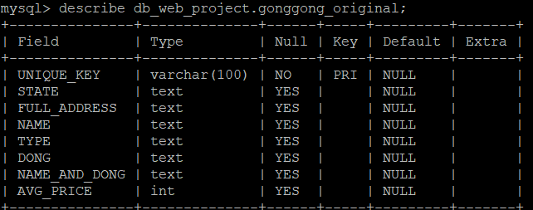
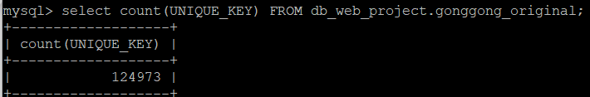
Data Collection - Restaurant Information
2. Preprocessing the data in MySQL. Finally, there are 124,973 restaurants data.

Slide 20
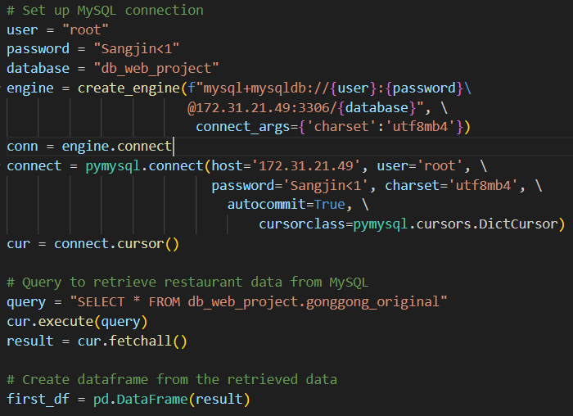
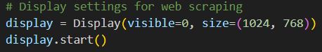
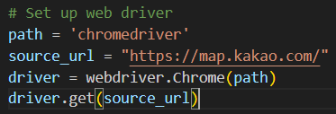
Data Collection – Review and Score
3. Collect the review and rating data from Kakaomap. Data was collected by crawling code and we search the restaurant using gonggong_original’s NAME_AND_DONG column which in the MySQL.
- Retrieve the 'gonggong_original' table from MySQL using Python.
- Setting up crawling on EC2.
＊AWS EC2 is not a GUI environment, so a virtual window must be displayed when crawling.

Slide 21
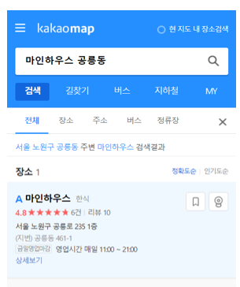
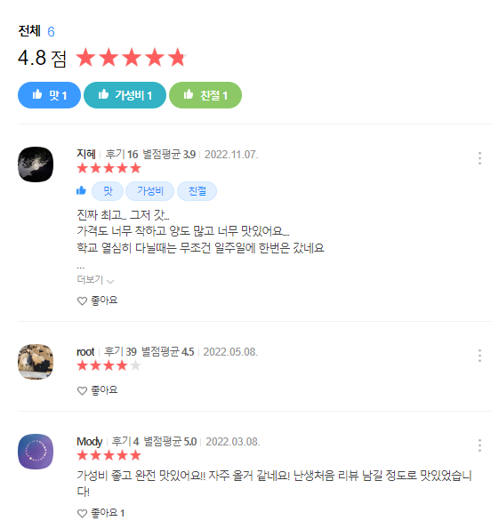
Data Collection – Review and Score
3. Collect the review and rating data from Kakaomap. Data was collected by crawling code and we search the restaurant using gonggong_original’s NAME_AND_DONG column which in the MySQL.
Review without content will be processed by MySQL later

Slide 22
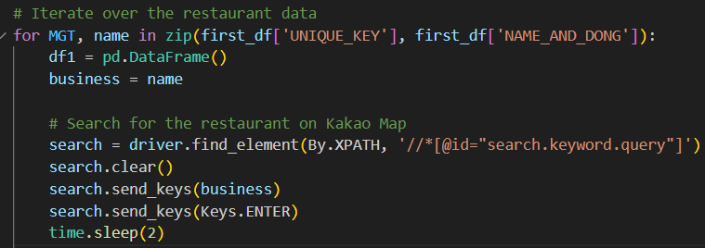
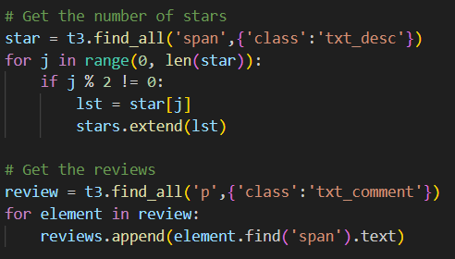
Data Collection - Review and Score
3. Collect the review and rating data from Kakaomap. Data was collected by crawling code and we search the restaurant using gonggong_original’s NAME_AND_DONG column which in the MySQL.
- Crawling code
＊Restaurants with zero reviews are passed

Slide 23
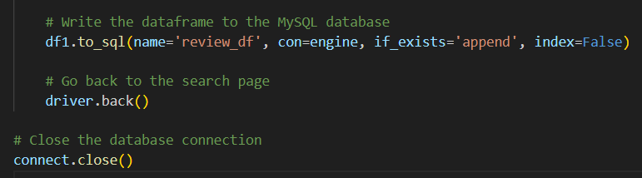
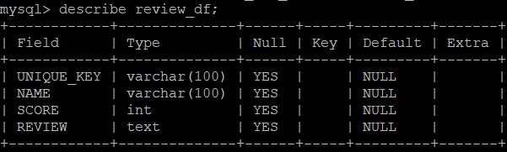
Data Collection - Review and Score
4. Making the new dataframe contained UNIQUE_KEY, NAME_AND_DONG, SCORE, REVIEW what we collected from Kakaomap and Stored the dataframe in MySQL.
- Storing the dataframe into MySQL’s review_df table
－Deleted NULL review data
DELETE FROM review_df WHERE REVIEW=""

Slide 24
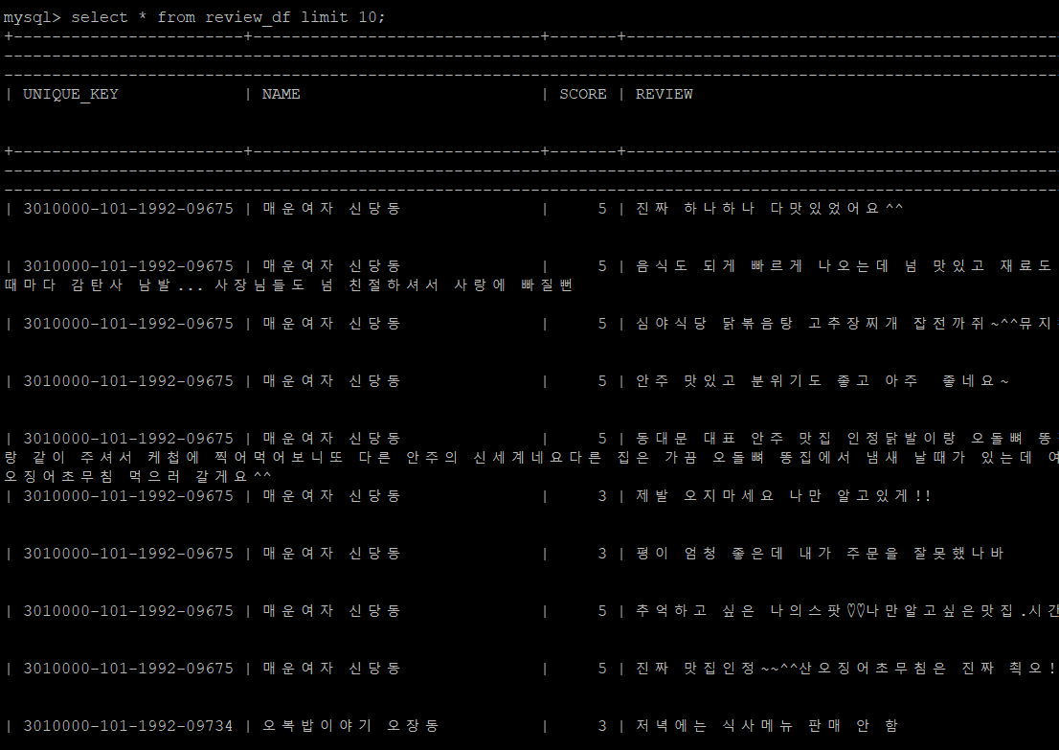
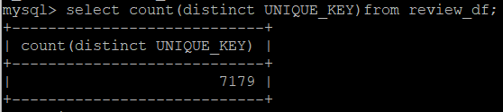
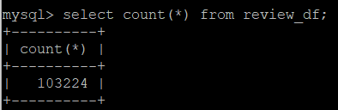
Data Collection - Review and Score
4. Making the new dataframe contained UNIQUE_KEY, NAME_AND_DONG, SCORE, REVIEW what we collected from Kakaomap and Stored the dataframe in MySQL.
review_df
# of restaurant : 7,179
# of review : 103,224

Slide 25
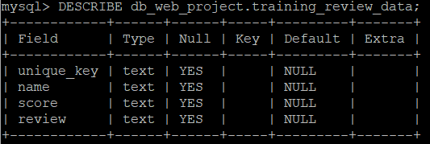
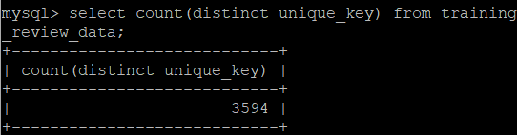
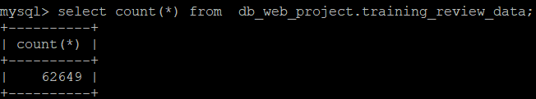
Data Collection - Review and Score
4. Making the new dataframe contained UNIQUE_KEY, NAME_AND_DONG, SCORE, REVIEW what we collected from Kakaomap and Stored the dataframe in MySQL.
- We also collected training data set to make classification model
# of restaurant : 3,594
# of review : 62,649

Slide 26
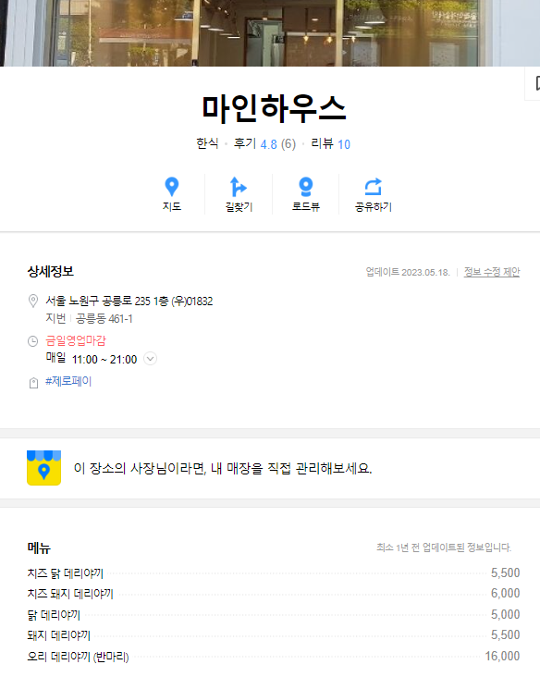
Data Collection – Price and Menu
5. Collecting the menus and each price using review_df’s NAME_AND_DONG in MySQL since we want to collect menus of restaurant which have review data. (Process is very similar)
- Collect menu data only from restaurants where reviews are collected
- Pass restaurants where menus are not registered

Slide 27
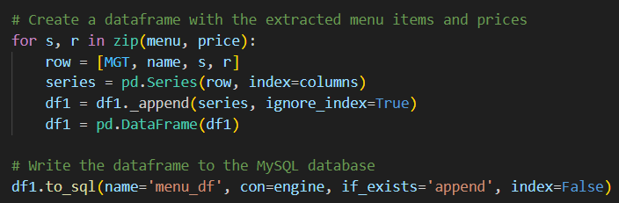
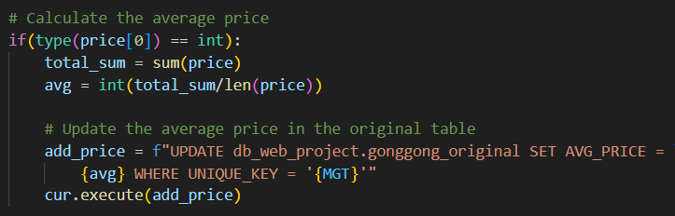
Data Collection – Price and Menu
5. Collecting the menus and each price using review_df’s NAME_AND_DONG in MySQL since we want to collect menus of restaurant which have review data. (Process is very similar)
- Storing the menus and price in the menu_df of MySQL table
- Calculate the average price and Updating the average price in the 'gonggong_original' table

Slide 28
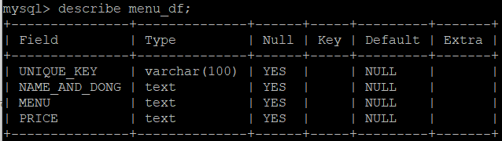
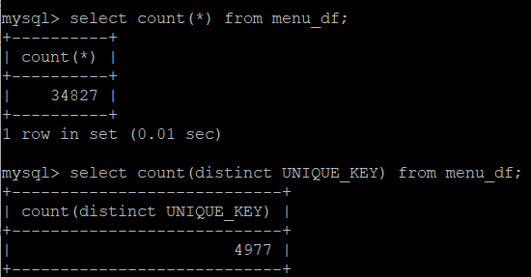
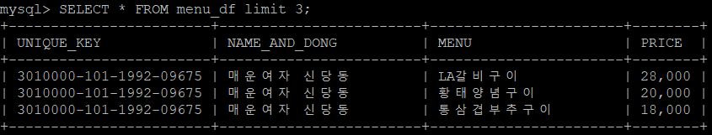
Data Collection - Price and Menu
5. Collecting the menus and each price using review_df’s NAME_AND_DONG in MySQL since we want to collect menus of restaurant which have review data. (Process is very similar)
# of menu and price data : 34,827
menu_df

Slide 29
04. Data Analysis

Slide 30

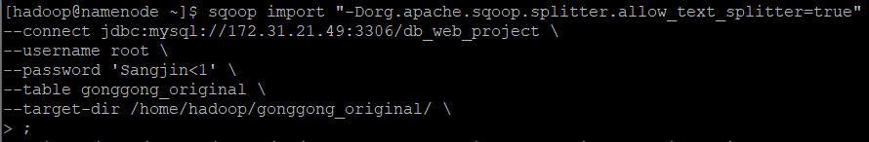
Data Transfer to HDFS
1. Transferring the collected data into HDFS using SQOOP
*Transfers data to HDFS and uses SPARK to analyze data and create a data classification model in a distributed environment
- Transfer the gonggong_original, review_df, training_review_data

Slide 31
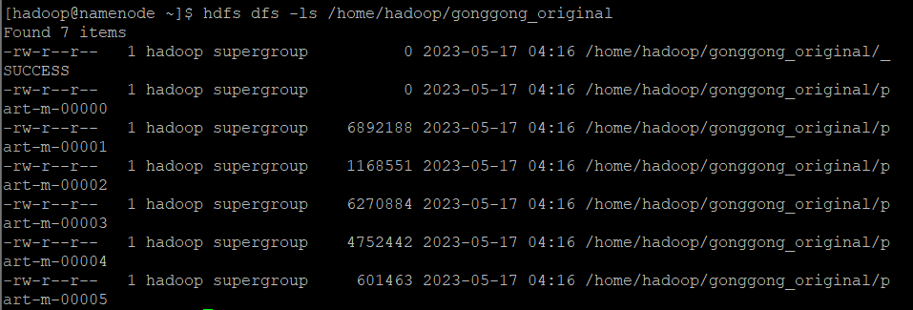
Data Transfer to HDFS
1. Transferring the collected data into HDFS using SQOOP
Result: gonggong_original
Result: training_review_data
Result: review_df

Slide 32

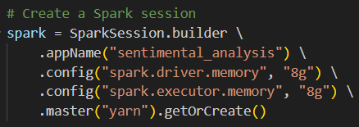
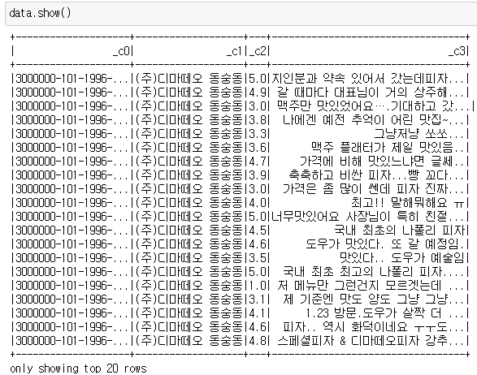
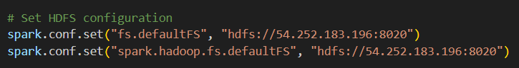
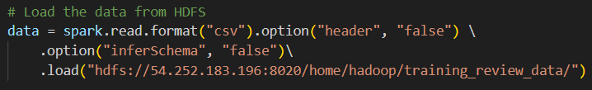
Data Analysis
2. Creating a SPARK session to analysis using the data from HDFS.
We used Pyspark to execute SPARK in Python.
- Create a Spark session
Added the option to set the memory size of the spark directly to prevent the memory from running out of memory
- Set HDFS configuration and Loading the training dataset from HDFS

Slide 33
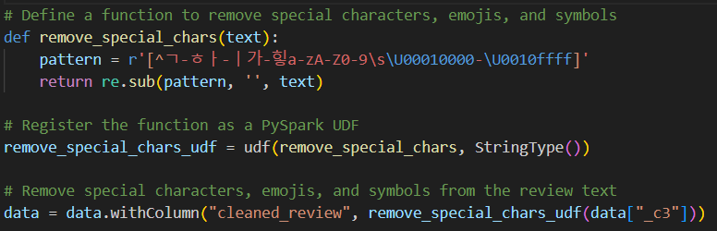
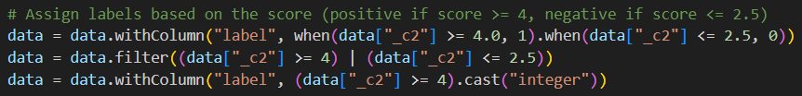
Data Analysis
2. Define the preprocessing functions using Pyspark library
Cleaned_review is created by removing emoticons, special symbols, etc. from the review
3. Divide the learning group by setting the positive to 4 points or more and negative 2.5 points or less
Why are positives set to 4 or more and negatives set to 2.5 or less?
To make the model learn dichotomically without considering neutral reviews

Slide 34
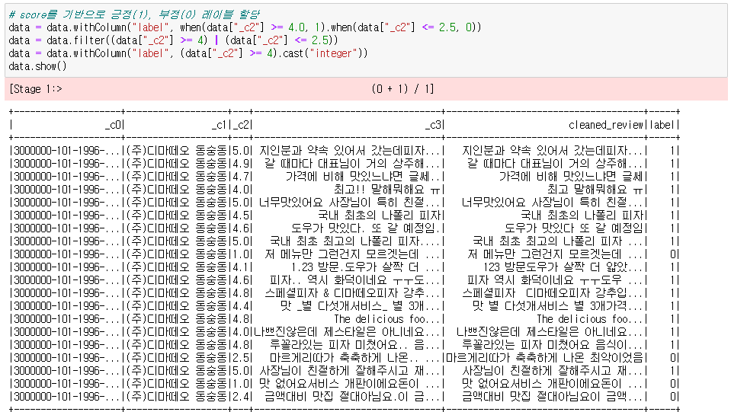
Data Analysis
2. Define the preprocessing functions using Pyspark library
3. Divide the learning group by setting the positive to 4 points or more and negative 2.5 points or less

Slide 35
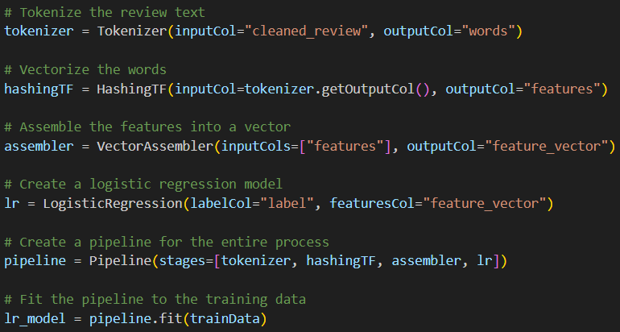
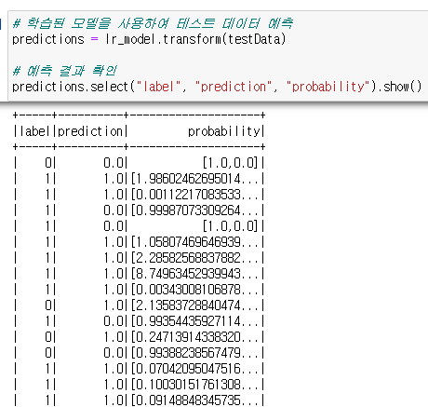
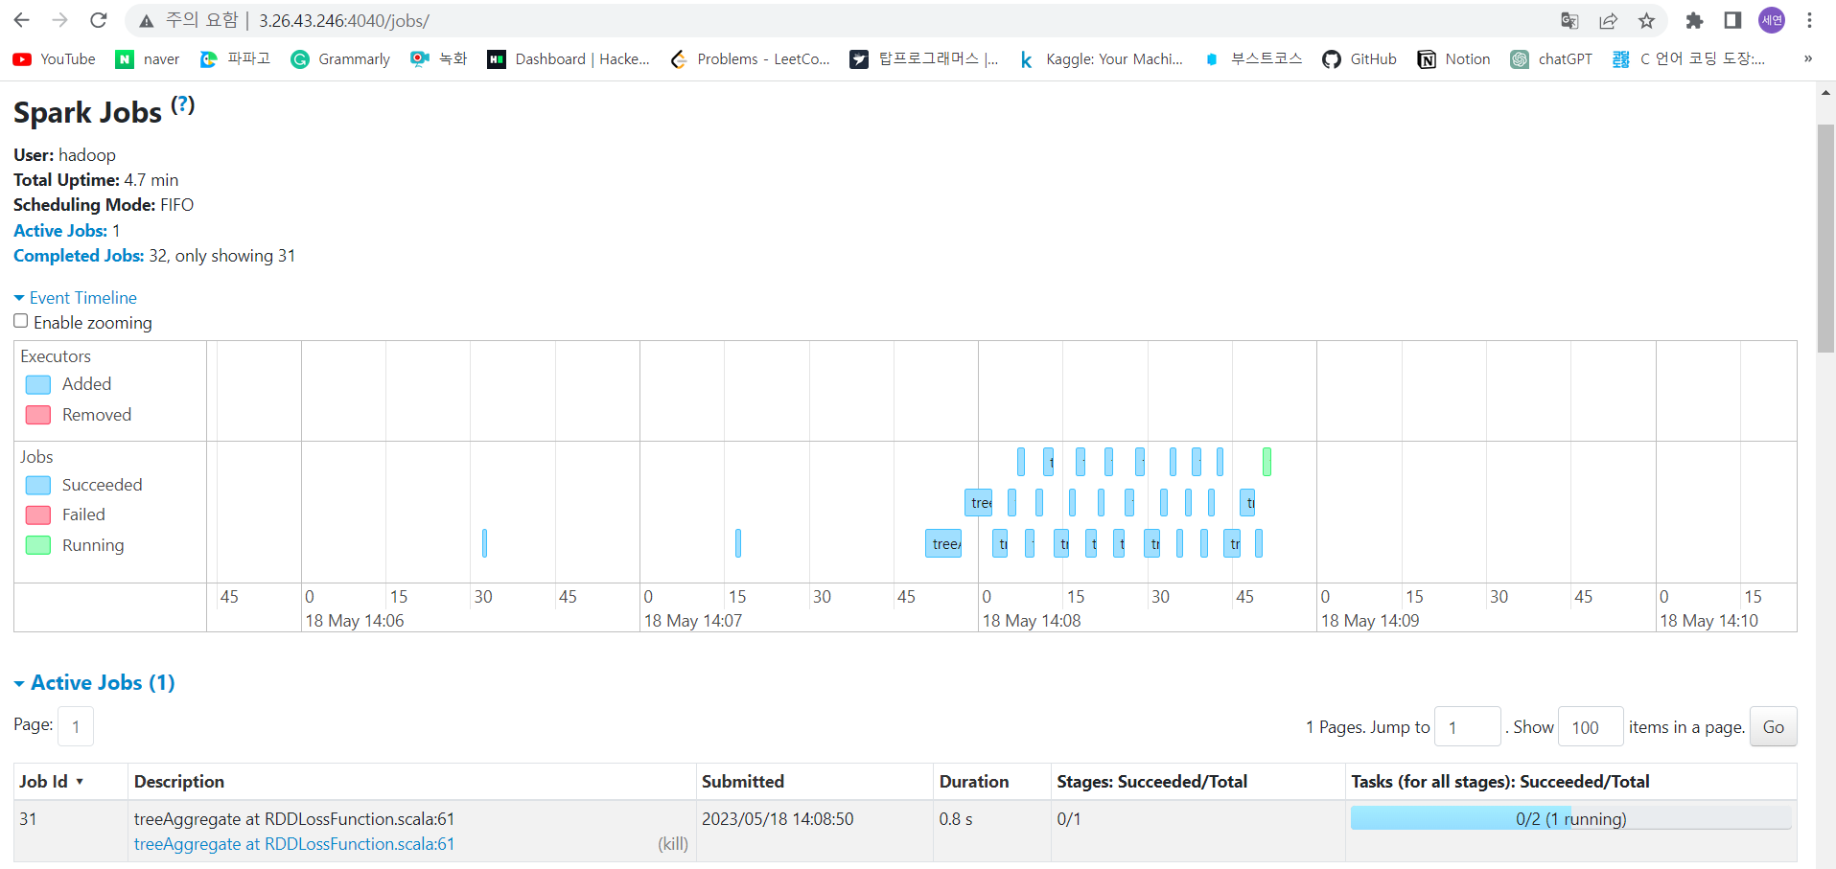
Data Analysis
4. Model learning with logistic regression
5. Checking model performance with test data

Slide 36
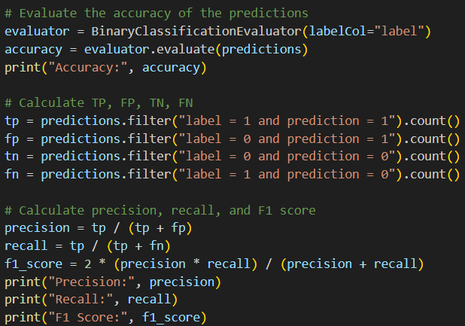


Data Analysis
5. Checking model performance with test data
Adopted as a logistic regression because it scored high in most performance evaluations

Slide 37




Data Analysis
6. Apply the model to review_df’s review
7. After analysis, save to HDFS in column labeled 'label' with 1 positive analysis result and 0 negative analysis result
Use the select function to add a label column that is the result of prediction to the imported review_df
Directories must be created in advance when saving results from Pyspark to HDFS
RESULT

Slide 38



Data Transfer into MySQL
8. Move data containing analysis results in HDFS to MySQL using SQOOP
*When exporting from HDFS to MySQL, you must create a table in MySQL in advance

Slide 39
05. Web Programming

Slide 40


Web Programming
1. Building Web Server
By phyhon web framework "Flask"
Making application with Python available.
- install Flask in virtual environment

Slide 41





Web Programming
2. Make structure of html

Slide 42

Web Programming
3. Write a JavaScript code that sends the input value to the server and returns the value sent from the server
App.py
To send and receive data asynchronously with servers,
Ajax's POST was used with form of jquery

Slide 43


Web Programming
4. Write the server code (app.py)
By routing with ['POST']
Input value from html is given.
Run other python codes as object
If all interpret finished, send response data as json to js.

Slide 44
Web Programming
4.1. Take key elements in form of dictionary to inform on web from mysql gonggong_df table
4.4. Take menus and price of restaurant from mysql menu_df table
4.2. Make four word clouds and save it in img
Postive and Negative
with 2 standard : star_point from site and sentimental analysis
4.3. Make the map and bar graph of the restaruants which town and type are same.
To do this connect on mysql location_df table
Map save as html, graph as img

Slide 45





Web Programming
4.1.
4.2.
4.3.
4.4.
4.3.

Slide 46
Web Programming
5. js code to represent on html
The simple information of restaruant
is displayed as text
The image files saved by server replace the remain images
The html files saved by server is represented as iframe
The menu information is changed into form of html and represented as table

Slide 47
06. Result／Limitation

Slide 48
















Service Overview
SEOUL RES
샹츠마라 공릉점
Info.
Pros Review Keywords
Cons Review Keywords
Name: 샹츠마라 공릉점
Type: 중식당
Address: 서울 노원구 공릉로 229-1 101
Rating: ⭐4.56/5
Map
Primary menu Price
Primary Menu

Slide 49




Result

Slide 50

Result

Slide 51
Limitation
1
Crawling process takes a long time.
2
Need to improve the accuracy and performance of the classification model
🡪 Consider using various models to identify the one with the highest accuracy.
3
The average price calculation using all registered menus results in decreased accuracy
🡪 Require specific menu data for each restaurant.
4
When comparing restaurant menu prices, there are too many comparisons between restaurants with a wide range of categories
🡪 Require a model that classifies restaurants based on their menu types

